Slide 1



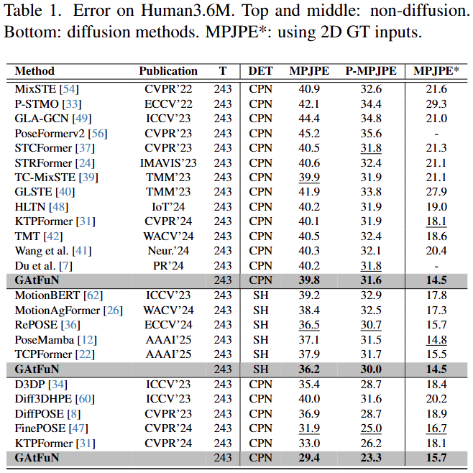
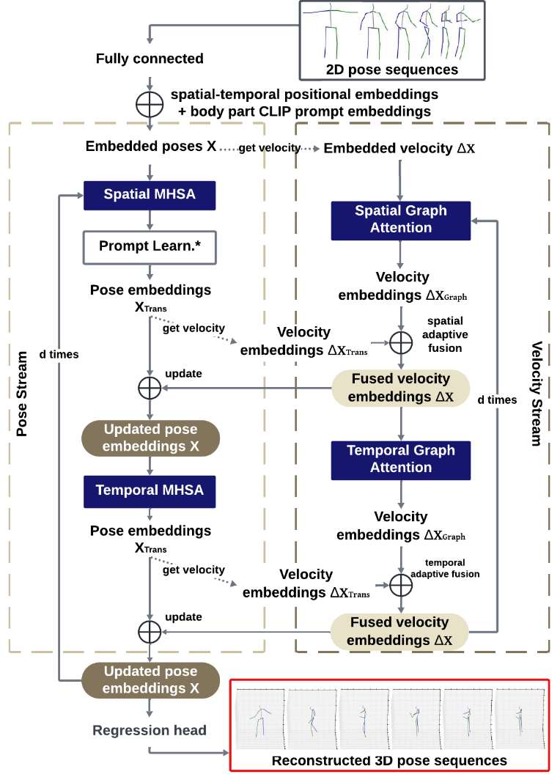
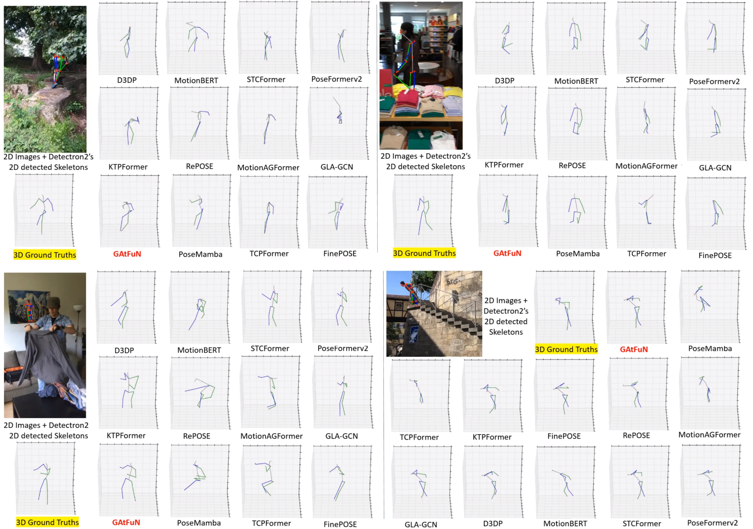
Title
Authors
Computer Vision and Intelligent Systems Lab
Background and Motivation
Components
Results
Describe the background and motivation of the work.
Describe each component in detail.
Describe each table and graph.
Describe each graph
Method
Provide an overall architecture of the proposed method
Describe the key idea of the proposed method
Describe the new component(s) that address the problems.
Describe the new component(s) that address the problems.
Experimental Results
Describe the dataset used
Describe the hyperparameters (if any)
Describe the conclusion of each table and plot.
THIS IS ONLY AN EXAMPLE
THIS IS ONLY AN EXAMPLE
Conclusion
Use bullet points to list key conclusions

